Slide 1
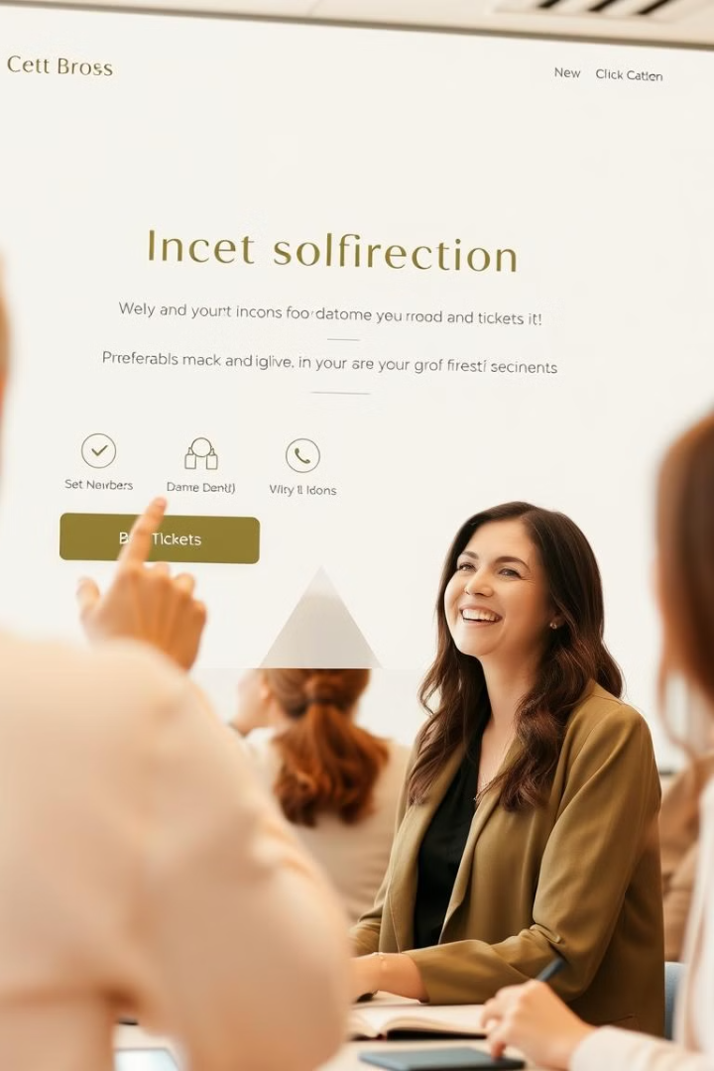

Online Ticket Booking
Online ticket booking has revolutionized the way we purchase tickets for events, travel, and more. With its unparalleled convenience and accessibility, this digital transformation has made the ticket booking experience seamless and enjoyable for consumers.
by Ashish

Slide 2
Convenience and Accessibility
Anytime, Anywhere
Reduced Hassle
Multiple Platforms
Global Reach
Online ticket booking allows customers to purchase tickets at their convenience, 24/7, from the comfort of their own homes or on-the-go.
Eliminating the need to physically visit ticket offices or stand in long queues, online booking saves time and effort.
Customers can access ticket booking platforms across a variety of devices, including smartphones, tablets, and computers.
Online booking allows customers to purchase tickets for events and experiences worldwide, expanding their horizons.

Slide 3
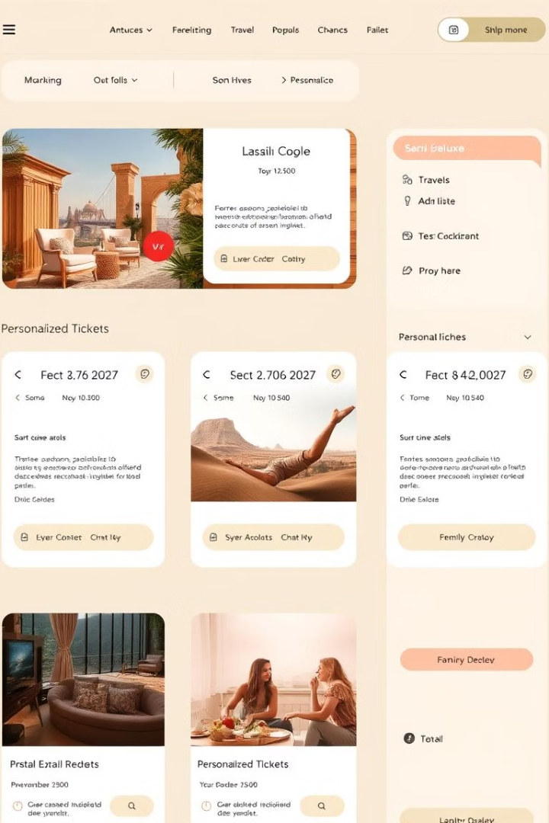
Variety of Ticket Options
Event Tickets
Travel Tickets
Customers can easily purchase tickets for concerts, festivals, sports events, and more, all in one convenient platform.
From airline tickets to train and bus passes, online booking simplifies the process of planning and booking trips.
Personalized Packages
Dynamic Pricing
Customers can customize their ticket purchases by adding extras like VIP experiences, merchandise, and more.
Online platforms offer dynamic pricing, allowing customers to take advantage of discounts and promotions.

Slide 4
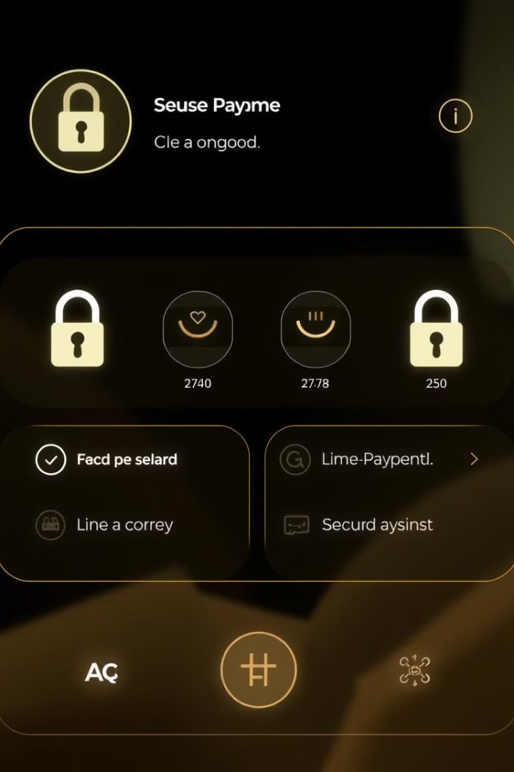




Secure Payment Processes
Encrypted Transactions
Fraud Protection
Online ticket booking platforms employ advanced encryption technologies to ensure the safety of financial transactions.
Robust security measures and fraud detection algorithms safeguard customers' personal and financial information.
Multiple Payment Options
Regulatory Compliance
Customers can choose from a variety of secure payment methods, including credit cards, digital wallets, and mobile payments.
Online ticket booking platforms adhere to industry standards and regulations to protect customer data and transactions.

Slide 5
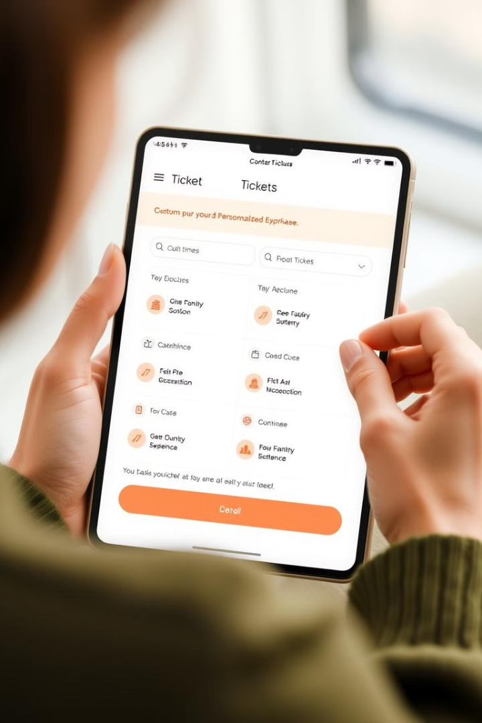
Personalization and Customization
1
User Profiles
Customers can create personalized profiles to save their preferences, purchase history, and payment information.
2
Tailored Recommendations
Online platforms use advanced algorithms to suggest relevant ticket options based on customer interests and past behavior.
3
Customized Experiences
Customers can add extras like VIP seating, meet-and-greets, and merchandise to personalize their ticket purchases.

Slide 6
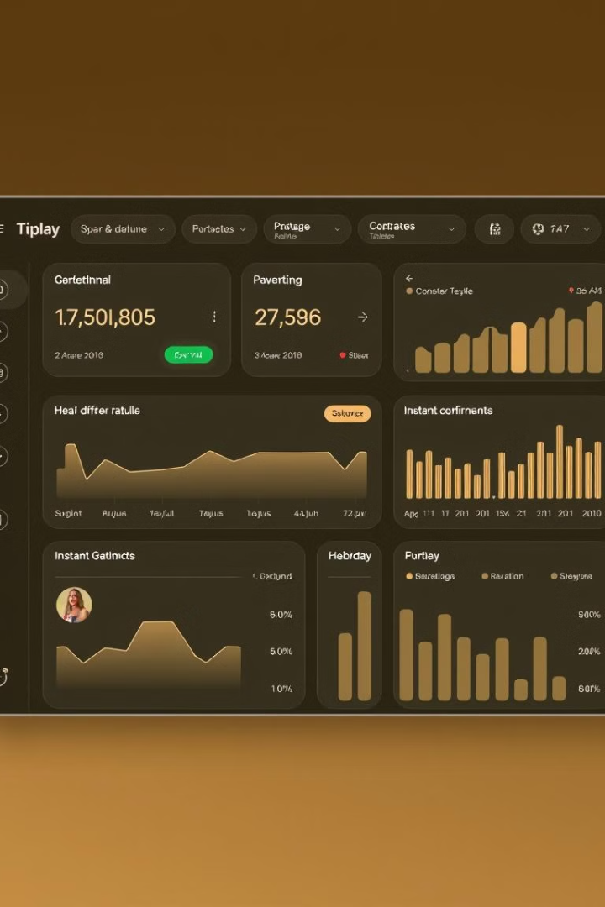
Real-Time Availability and Updates
99%
Inventory Accuracy
Online ticket booking platforms provide real-time updates on ticket availability, ensuring customers have accurate information.
5 min
Instant Confirmation
Customers receive instant confirmation of their ticket purchases, eliminating the wait for physical tickets.
24/7
Constant Accessibility
Online ticket booking is available around the clock, allowing customers to purchase tickets at their convenience.

Slide 7






The Future of Ticket Booking
1
Seamless Integration
2
Artificial Intelligence
3
Virtual and Augmented Reality
4
Blockchain Technology
5
Sustainability
As technology continues to evolve, the future of online ticket booking will likely feature seamless integration with other platforms, the use of AI for personalized recommendations, virtual and augmented reality to enhance the booking experience, blockchain for secure and transparent transactions, and sustainable practices to minimize environmental impact.
6

Slide 8
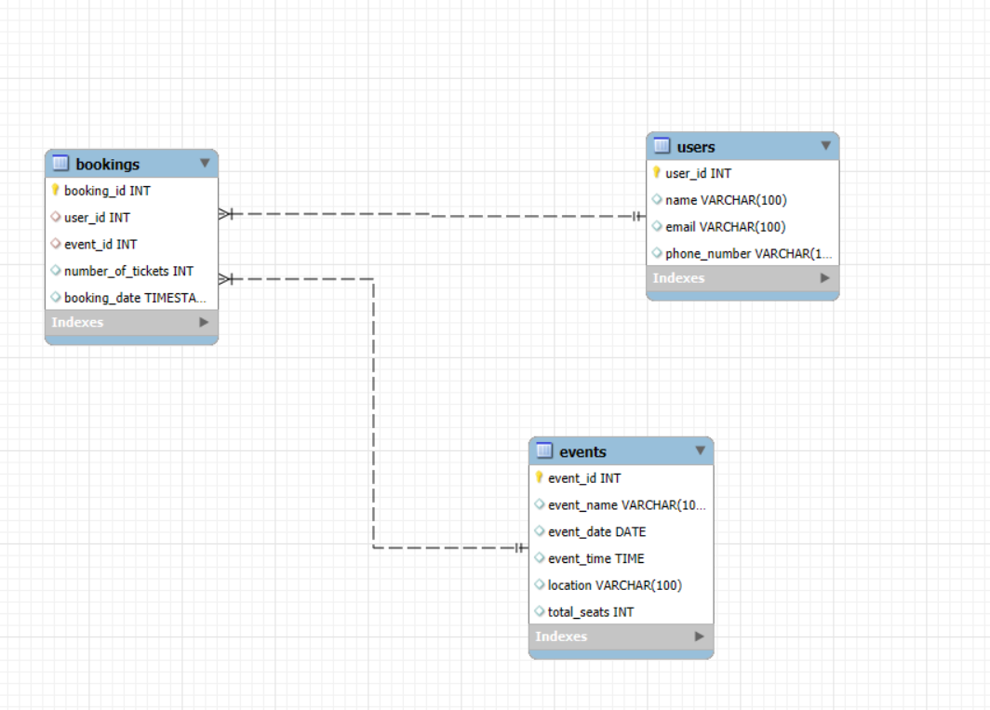
ER DIAGRAM

Slide 9
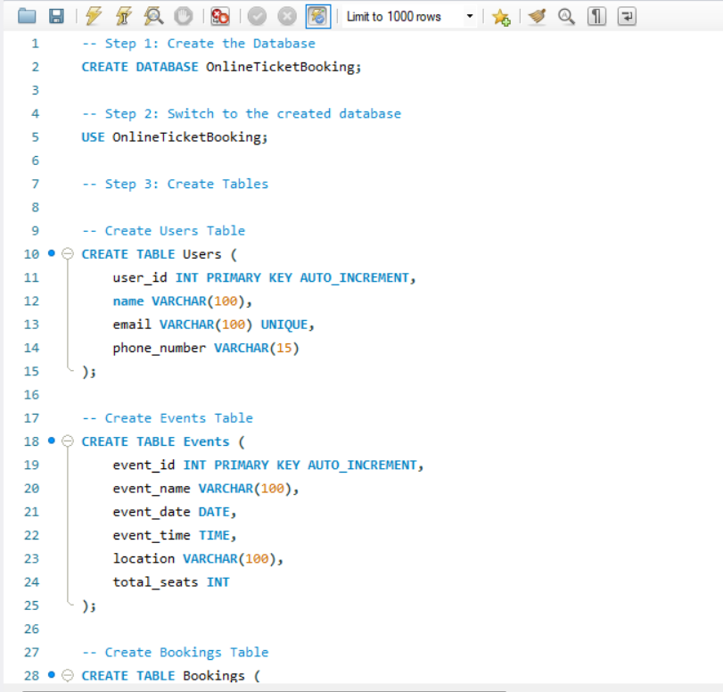
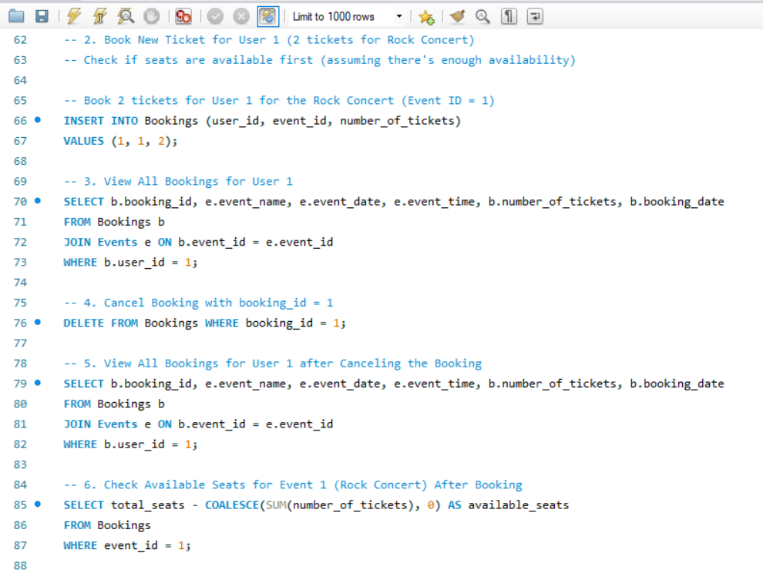

Slide 10
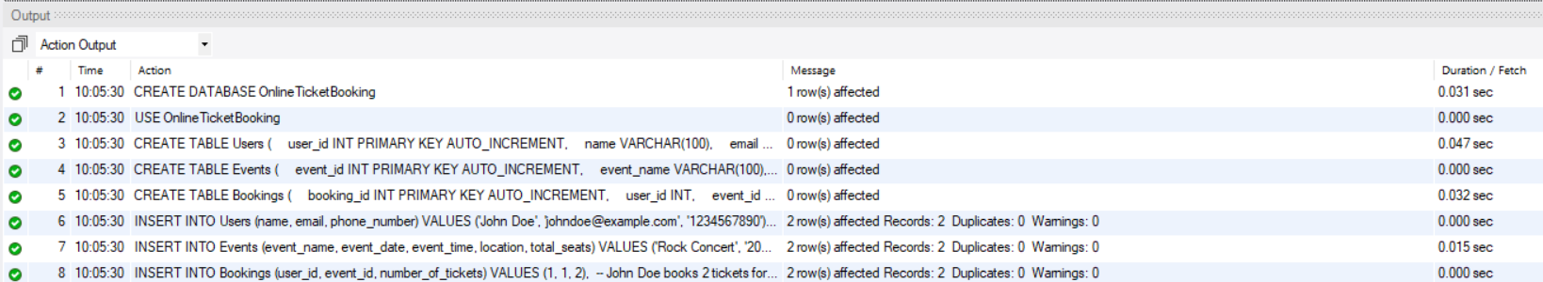

Slide 11
